Slide 1
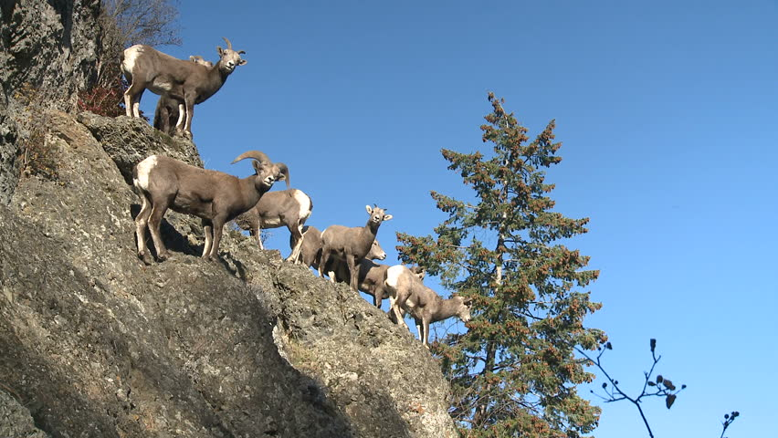
How Many Bighorns Can Live in this Forest?

Slide 2
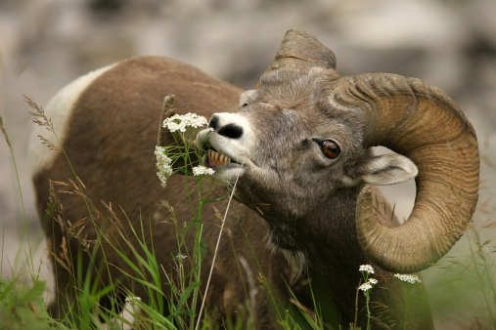
Simulation
You have just simulated a year’s worth of living as a bighorn sheep.
The token you collected were food. The numbers on each token represents a specific number of pounds of food eaten.
1) Add up the amount of pounds of all your food. Record this number down.

Slide 3
Simulation
This simulation uses real data from a real herd in Texas.
The desert bighorn sheep in this area of Texas need 1,460 pounds of food a year to survive and be healthy (this is 4 pounds of weight vegetation a day).

Slide 4
Simulation
This simulation uses real data from a real herd in Texas.
The desert bighorn sheep in this area of Texas need 1,460 pounds of food a year to survive.
Did you survive, meeting or exceeding the 1,460 pounds?

Slide 5
1,460 Pounds
For those who met the required amount of food in order to survive, how healthy were you?
For example, humans could probably survive by eating only Bigmacs, fries, and donuts for every meal, but after a period of time would not be so healthy and could eventually die from heart disease or other health related issues.

Slide 6
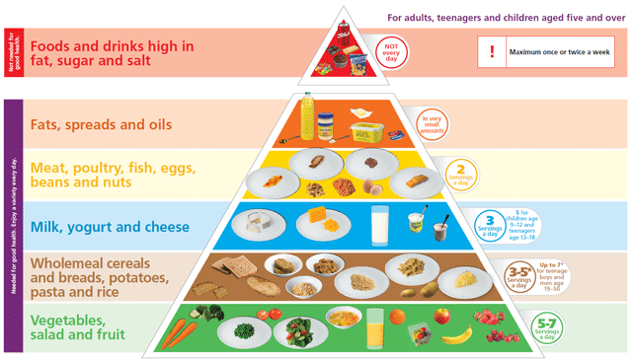
Food Pyramid for Humans
You may be familiar with this, which helps us eat a balanced diet of food.

Slide 7
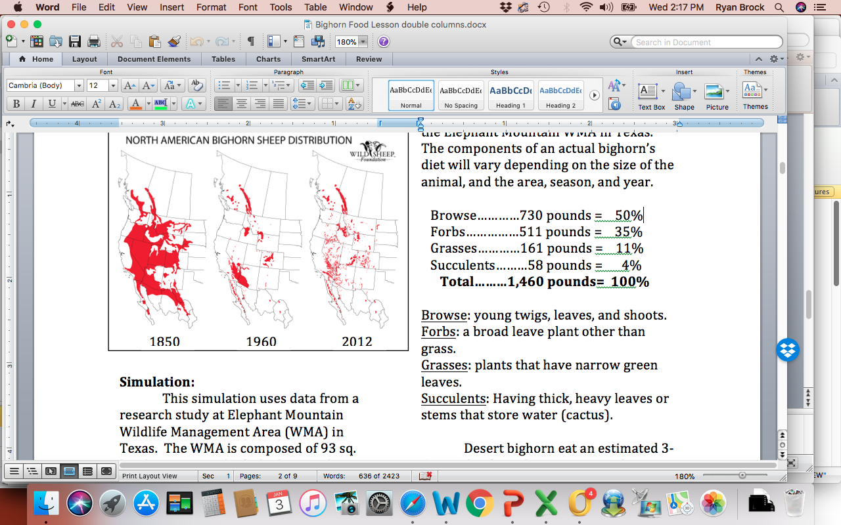
Healthy Bighorns
Desert bighorns in Texas eat 4 types of vegetation:

Slide 8
Healthy Bighorns
For desert bighorns in Texas, the following amounts provide the healthiest animals:

Slide 9
Find how healthy you are in each category:
  YELLOW tokens are browse
  RED tokens are forbs
  WHITE tokens are grasses
  ORANGE tokens are succulents
  To find percent for each category:
    Add up total number for a particular color. Then divide by total pounds of food you have. Next, multiply this by 100.
    Do this for each color.

Slide 10
Now Compare!
  YELLOW tokens are browse
  RED tokens are forbs
  WHITE tokens are grasses
  ORANGE tokens are succulents

Slide 11
Now Compare!
  You may have met the required pounds of food, but if you didn’t meet the correct percentages for each category, you might not be too healthy.
  Wild animals need to not only find enough food to eat, but eat a balanced diet as well. Many times, their balanced diet is dependent upon the seasons.
  If you can’t find enough food that grows during a particular season, you might starve during that season.

Slide 12
Simulation
The management area the sheep live on is composed of about 12 square miles suitable for bighorn habitat.
This amount of land only provides so many plants for the bighorn sheep to eat.

Slide 13
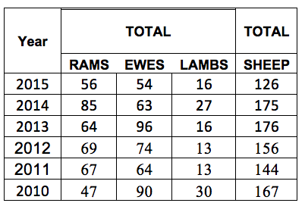
Animal Habitats Can Only Hold a Certain Amount of Animals
In 1987 twenty bighorn sheep were transplanted into the management area in Texas, where sheep previously lived but had died out.
Analyze the real data from the Texas herd:

Slide 14
Carrying Capacity
Do you see a pattern in amount of sheep each year? It seems like the numbers go up and down, but never go about the 170s.

Slide 15
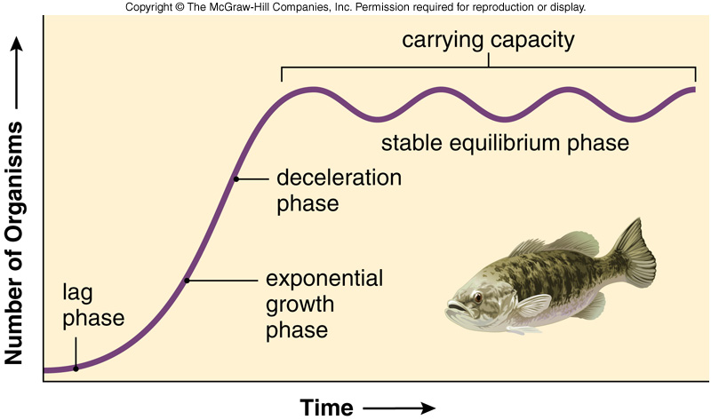
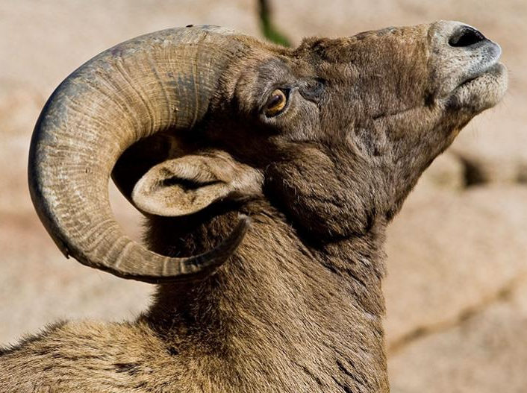
Carrying Capacity
Carrying capacity is the maximum population size of the species that an environment can sustain indefinitely, given the food, habitat, water and other necessities stay available in the environment.

Slide 16
Carrying Capacity

Slide 17
How many bighorns could live in this area?
We can calculate this:
  1) add up the total amount of food available (how much food we collected).
  2) Divide the total amount available by how much each sheep needs. In this case, we will divide by 1,460.
  3) This number is how many sheep can live in this area and be healthy.

